Slide 1
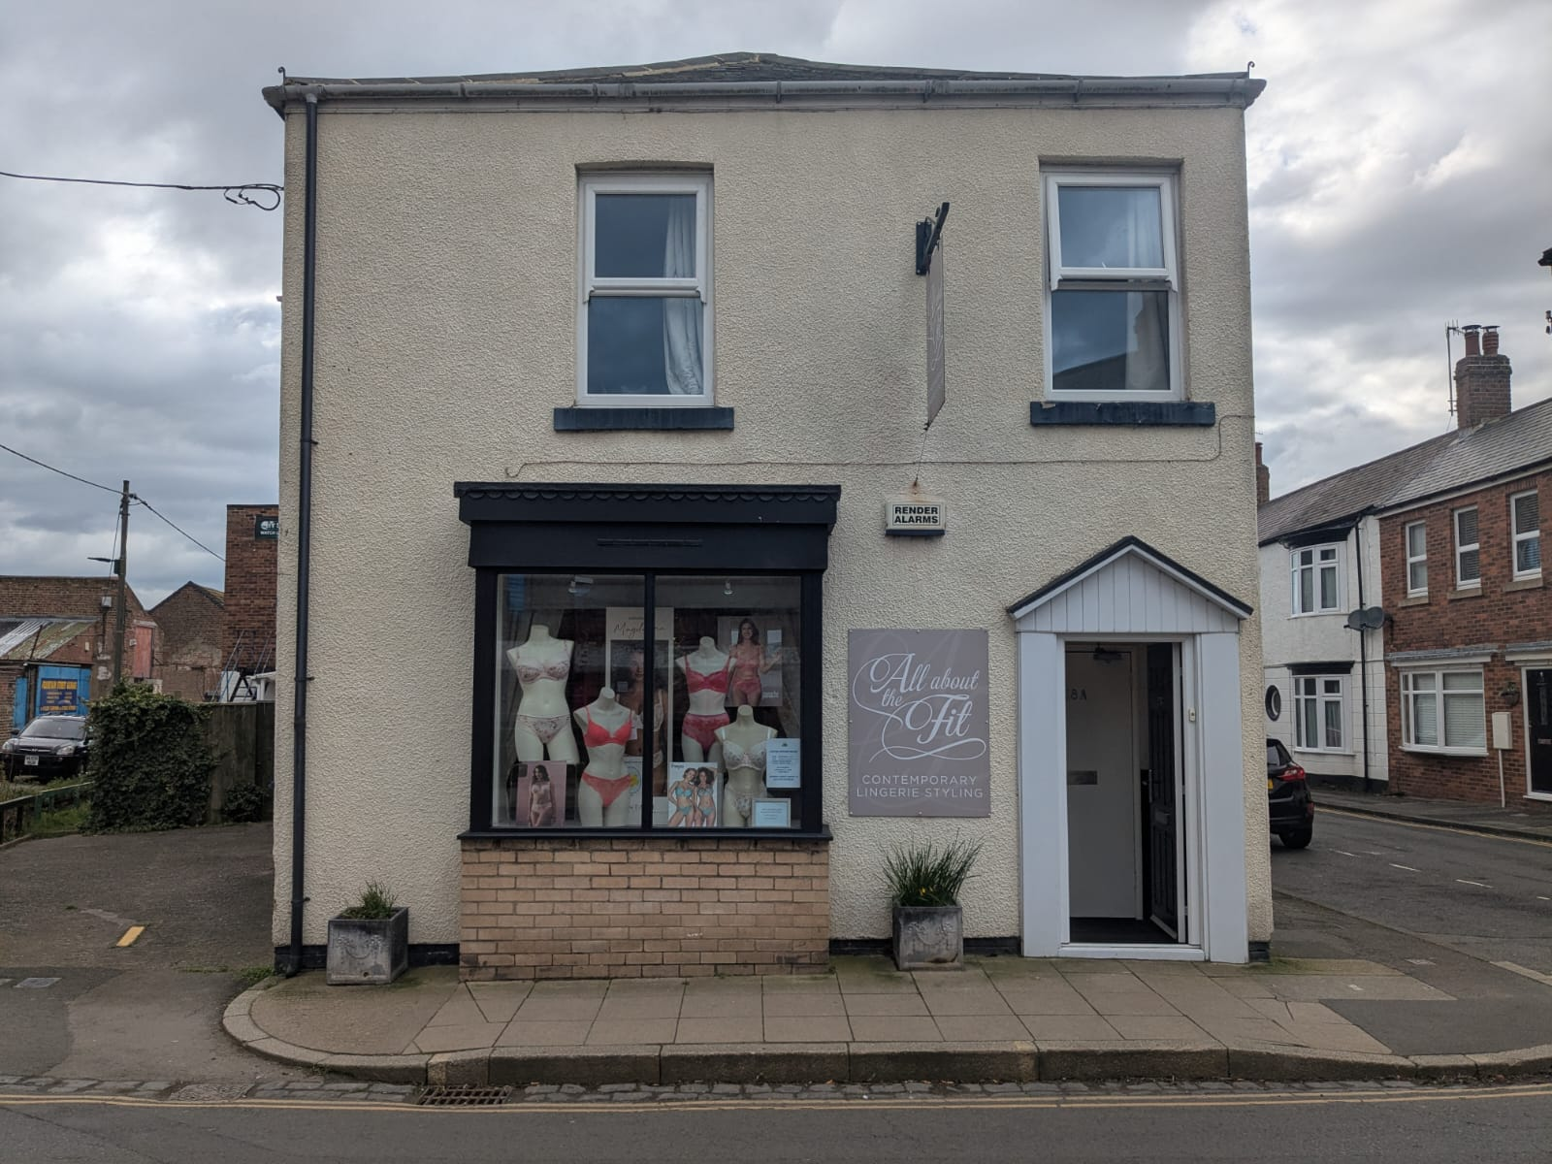
28A CHALONER STREET, GUISBOROUGH, TS14 6QD
TO LET: GROUND FLOOR RETAIL UNIT IN A POPULAR LOCATION

Slide 2
28A CHALONER STREET, GUISBOROUGH, TS14 6QD
TO LET: GROUND FLOOR RETAIL UNIT IN A POPULAR LOCATION
ACCOMMODATION
The property provides the following approximate areas (NIA):
Gross Frontage: 5.15 m (16 feet 1 inches)
Net Int Width: 4.45 m (14 feet 7 inches)
Shop Depth: 8.93 m (29 feet 3 inches)
Sales Area: 34.72 sq m (374 sq ft)
WC
PROPOSED TERMS
The unit is available to let at an asking rent of £10,200 per annum for a term of years to be agreed on an effectively full repairing and insuring lease.
RATING ASSESSMENT
The premises has a Rateable Value of £6,300.The property is subject to small business rate relief and therefore there are no rates payable.
LEGAL FEES
Each party is responsible for their own legal fees in respect of this transaction.
VAT
The premises are not elected for VAT.
LOCATION
The property is located within the popular market town of Guisborough, 22 miles north-west of Whitby and 10.5 miles south-east of Middlesbrough. The town sits on the edge of the North Yorkshire Moors.
The property is situated on the west side of Chaloner Street, a popular commercial location, perpendicular to Westgate. The property holds close proximity to Fountain Street Car Park and renovated Town Hall. Chaloner Street is one of the most popular streets in Guisborough with very low vacancy rates and a variety of commercial occupiers.
Occupiers in the immediate vicinity include Brass Monkey, Flower Box, J’s Gents Hairdressing, Guisborough Book Shop, Sergio’s Italian, The Priory Bistro and Line Two.
DESCRIPTION
The property comprises a ground floor retail unit within a mixed use two storey building arranged as a sales floor and staff amenities.
Previously occupied as a retail unit by ‘All About The Fit’ for a number of years, the property is suitable for a variety of uses and is available immediately.#
The landlord would consider combining the unit with the adjacent unit. Please enquire for further details.

Slide 3
28A CHALONER STREET, GUISBOROUGH, TS14 6QD
TO LET: GROUND FLOOR RETAIL UNIT IN A POPULAR LOCATION
ENQUIRIES
Contact Jack Robinson to discuss your interest.
Tel: 01642 713 303.
Email: jack@thomas-stevenson.co.uk
VIEWING
Viewings can be arranged by contacting Thomas : Stevenson direct.
Subject to contract.

Slide 4
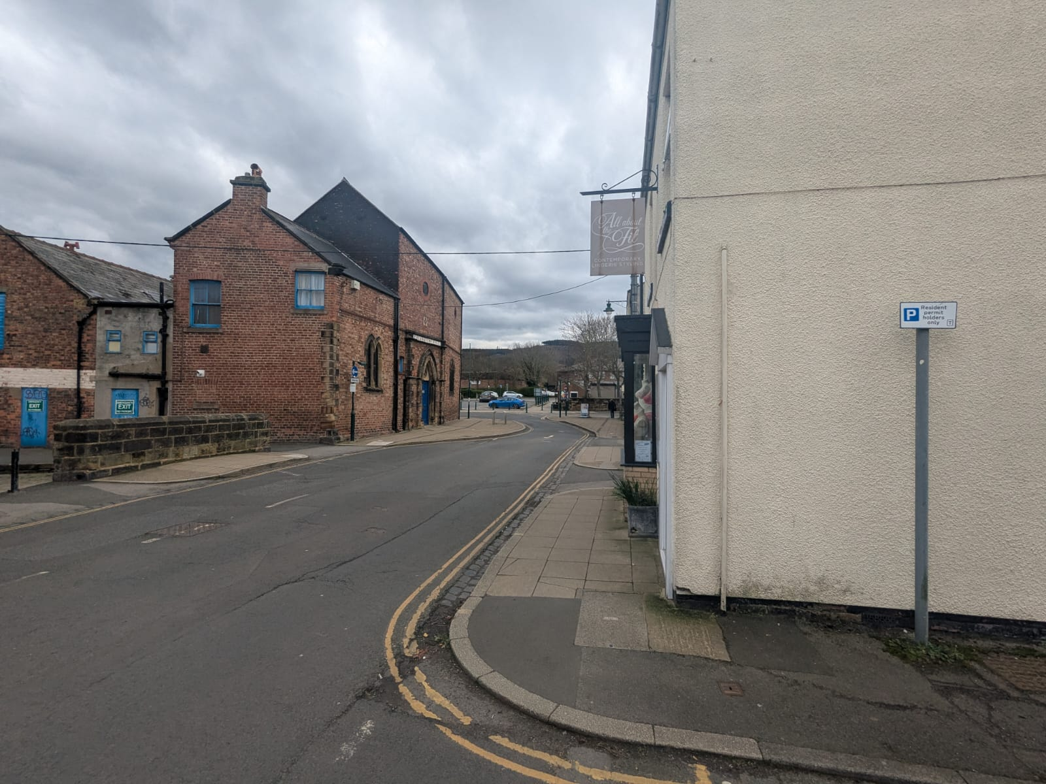
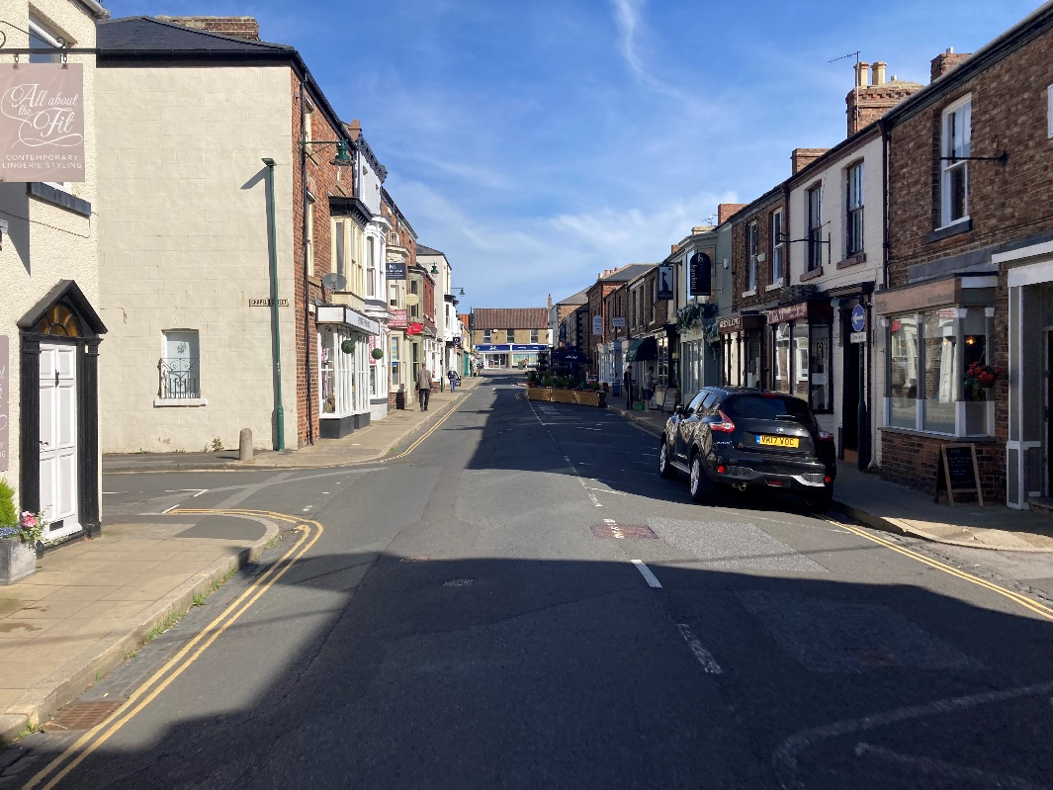
28A CHALONER STREET, GUISBOROUGH, TS14 6QD
TO LET: GROUND FLOOR RETAIL UNIT IN A POPULAR LOCATION

Slide 5
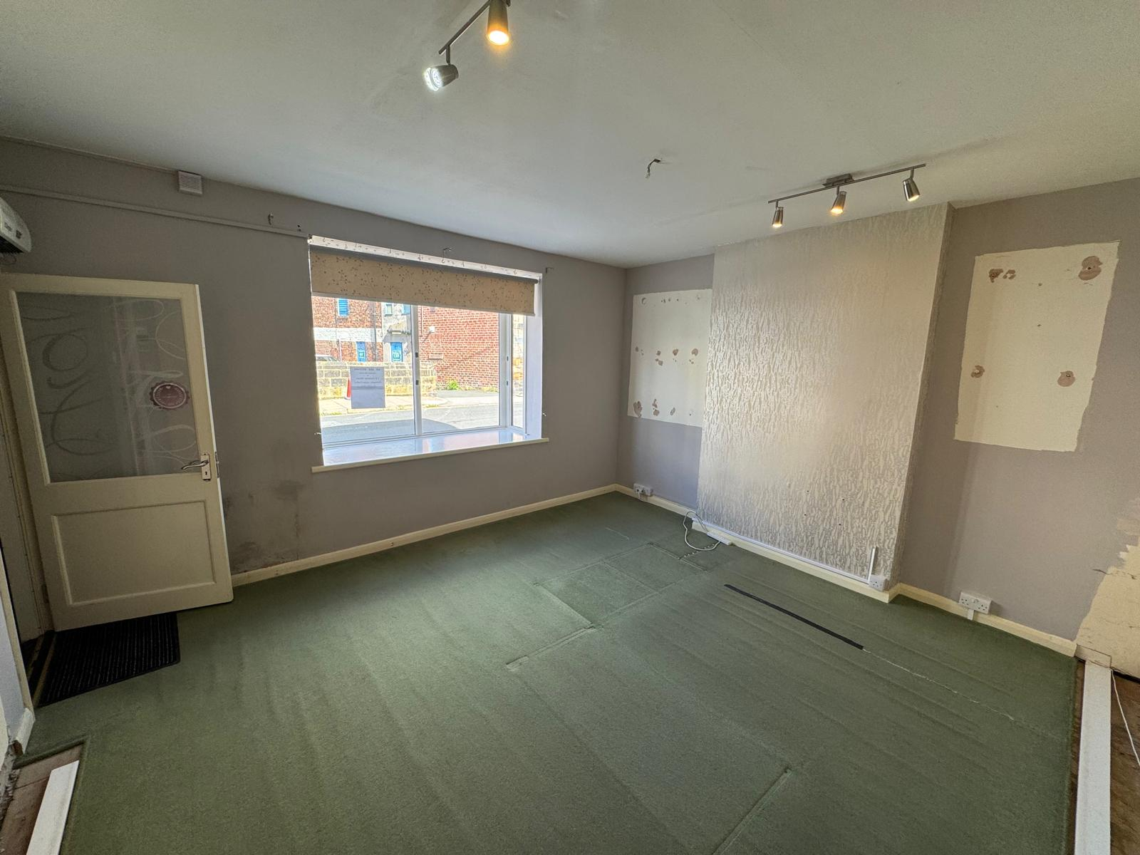
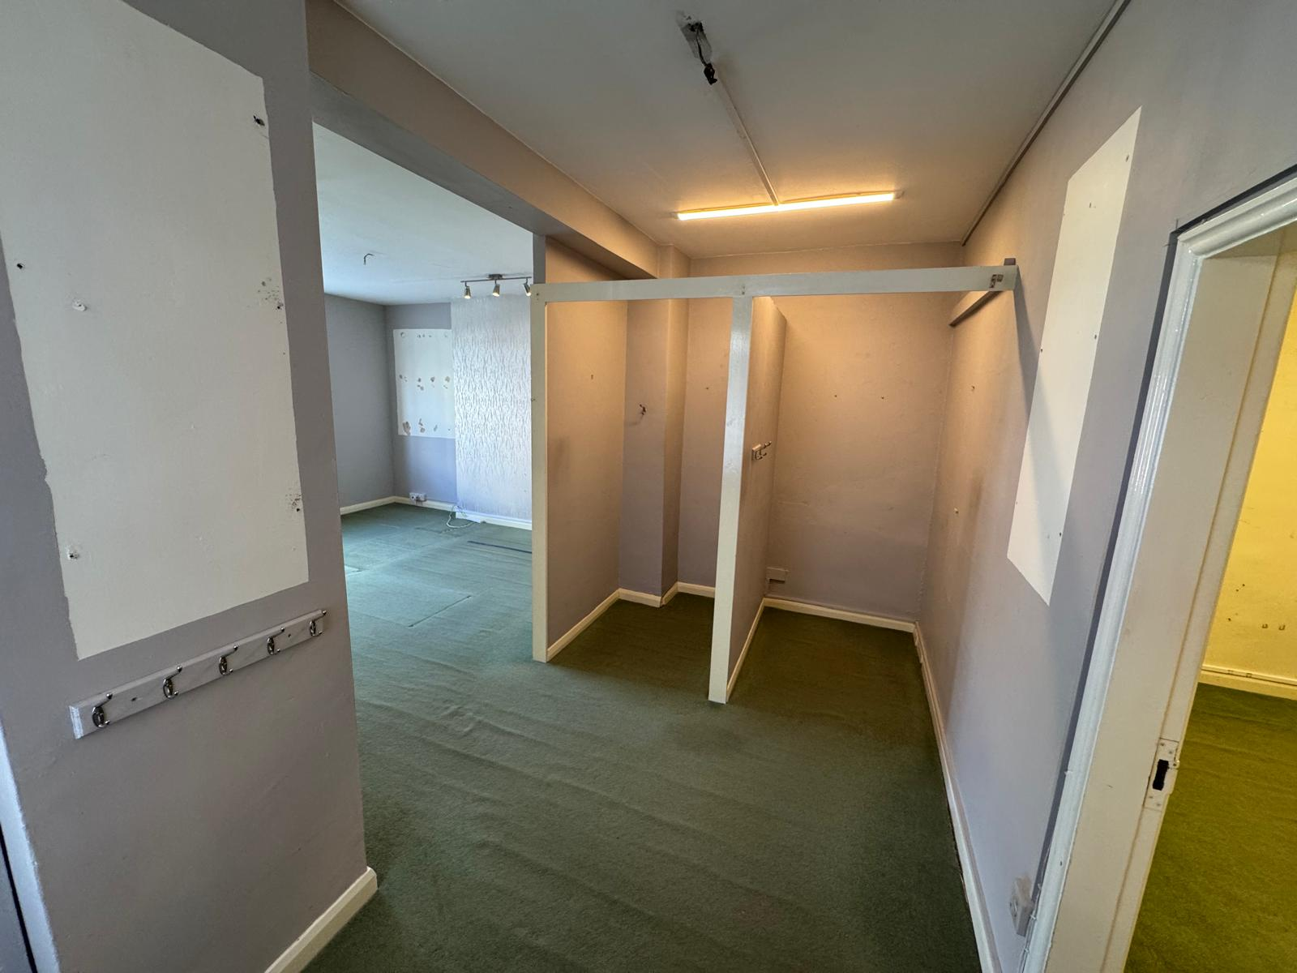
28A CHALONER STREET, GUISBOROUGH, TS14 6QD
TO LET: GROUND FLOOR RETAIL UNIT IN A POPULAR LOCATION

Slide 6
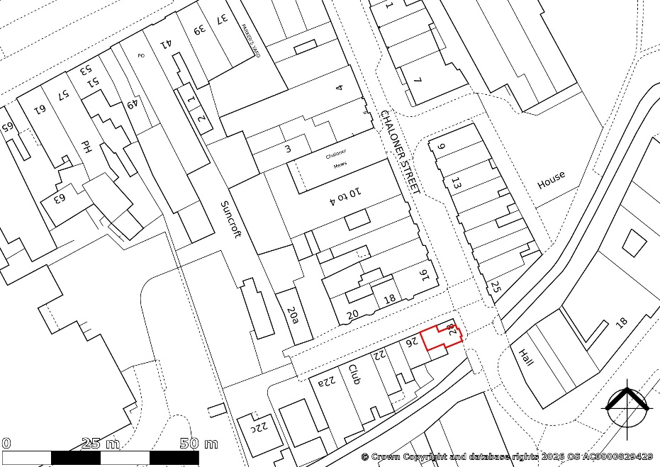
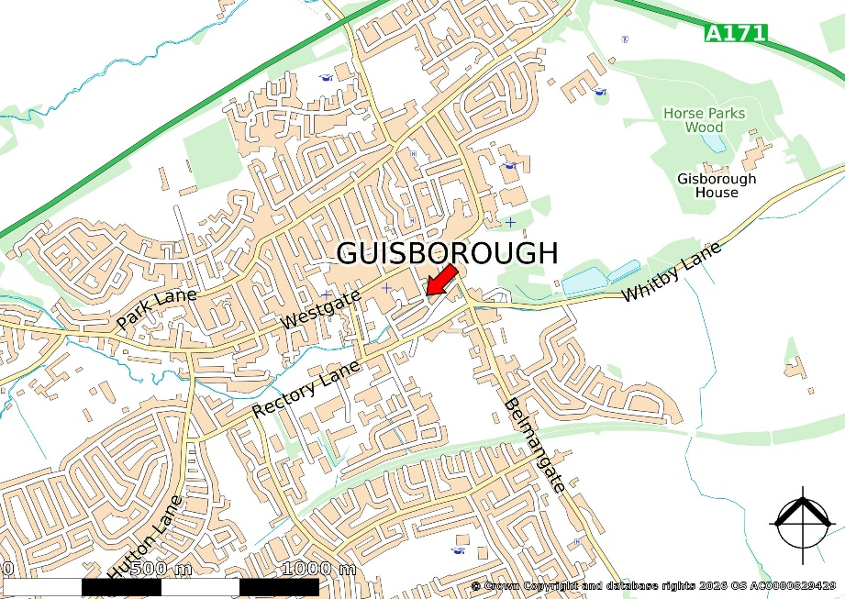
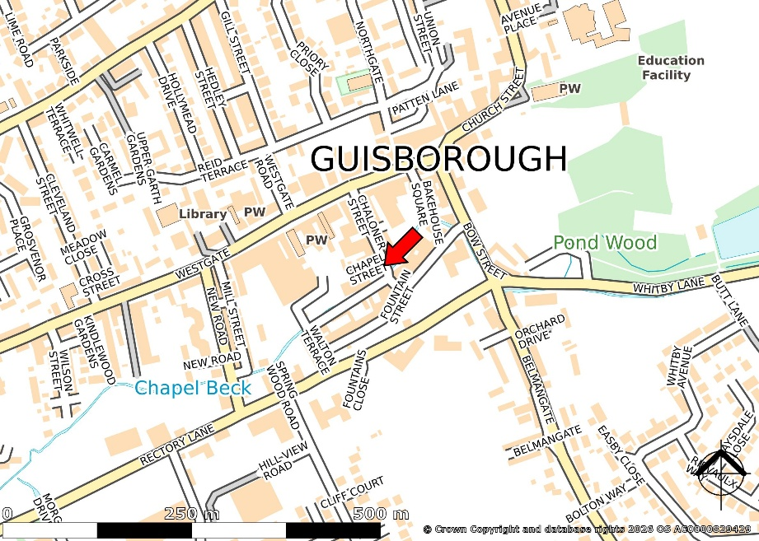
28A CHALONER STREET, GUISBOROUGH, TS14 6QD
TO LET: GROUND FLOOR RETAIL UNIT IN A POPULAR LOCATION

Slide 7

28A CHALONER STREET, GUISBOROUGH, TS14 6QD
TO LET: GROUND FLOOR RETAIL UNIT IN A POPULAR LOCATION
MISREPRESENTATION ACT 1967 Thomas Stevenson for themselves and for the vendors/lessors of any property for whom they act, give notice that:
These particulars are a general outline only, for the guidance of prospective purchasers or tenants, and do not constitute the whole or any part of an offer or contract:
Thomas Stevenson cannot guarantee the accuracy of any description, dimensions, references to condition, necessary permissions for use and occupation and other details contained herein and prospective purchasers or tenants must not rely on them as statements of fact or representation and must satisfy themselves as to their accuracy:
No employee of Thomas Stevenson has any authority to make or give any representation or warranty or enter into any contract whatsoever in relation to the authority.
Prices/rents quoted in these particulars may be subject to VAT in addition; and
Thomas Stevenson will not be liable, in negligence or otherwise, for any loss arising from the use of these particulars.
Thomas : Stevenson can advise you in respect of:
Sales & Lettings Acquisitions Investment Property
Valuations
Property Management Compulsory Purchase Compensation Rent Reviews & Lease Renewals
EPC COMMISSIONED

